Slide 1
CAMPSYS
User Manual
STUDENT AFFAIR MODULE
V1.0

Slide 2
CONTENT
MAIN INTERFACE
STUDENT RECORD
How to add new student?
How to edit student record?
Additional Record
Qualification
School Academic
Extracurricular
Discipline
Hostel
How to delete student record?
View Student’s Detail
SEARCH
EXPORT

Slide 3
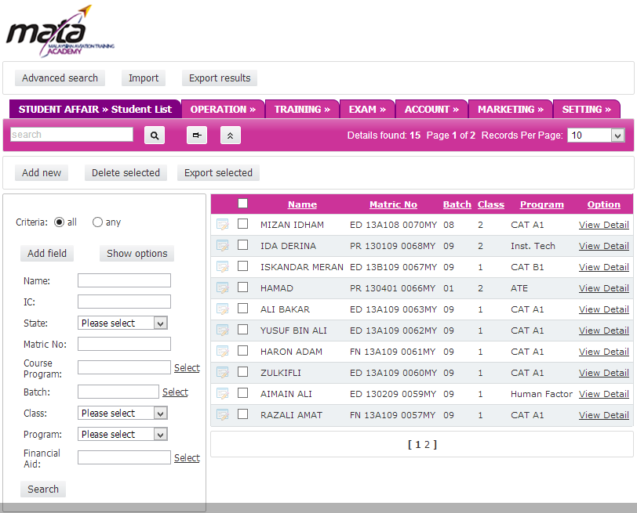
MAIN INTERFACE
QUICK SEARCH – Find student name quickly
DELETE -Permenantly delete selected record
EXPORT- Export selected records to Excel, Word etc
RECORD PER PAGE– Limit the record list per page
CHECKBOX – Can be selected for action. For example: Delete, Export
ADD NEW-
Add new record
SHOW OPTIONS-
Show range/interval input seach
ADD FIELD- Additional Search filter
VIEW DETAIL
Detail of Student Records
SEARCH PANEL- Search particular records
EDIT RECORD-Edit selected record details
PAGINATION- Navigate to other records page

Slide 4
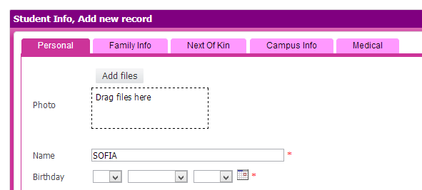
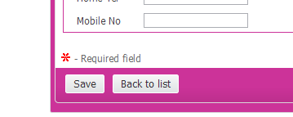
Student Record: How to add new student?
1
Click Add New button
2
Fill in all relevant field in each tab. (Personal, Family, Next of Kin, Campus Info, Medical ) Note: The asteric symbol is the compulsory field.
3
Click SUBMIT to save the record.

Slide 5
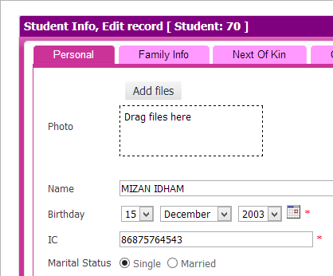
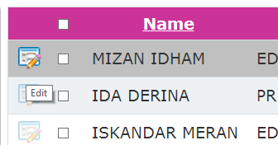
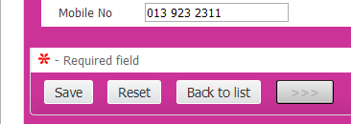
Student Record: How to edit student record?
1
Click EDIT button at student list
2
Click SAVE to update record.

Slide 6
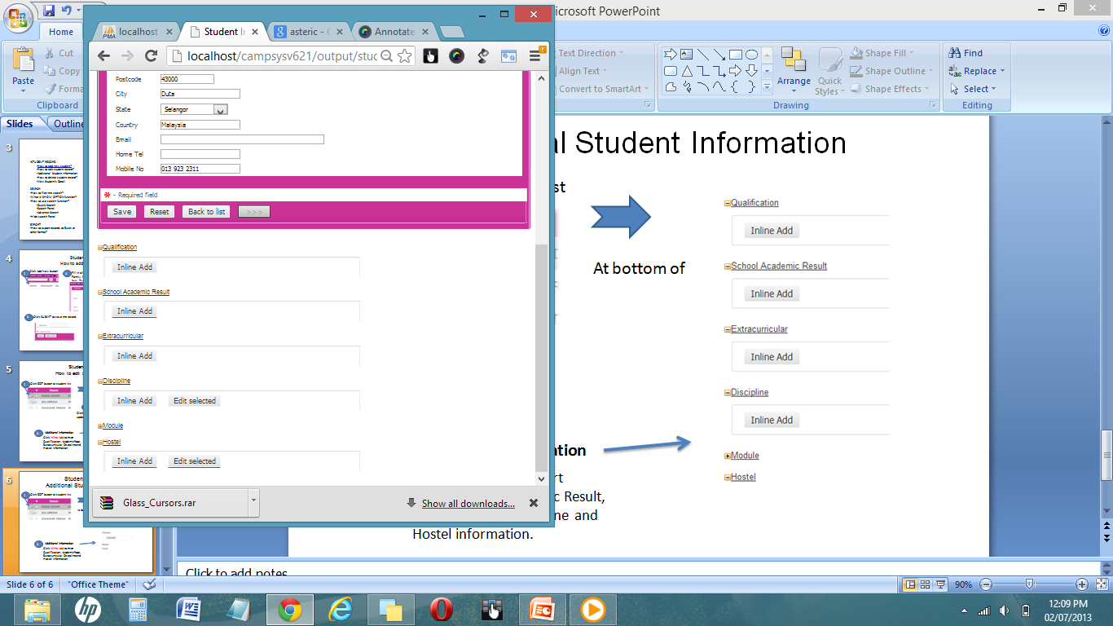
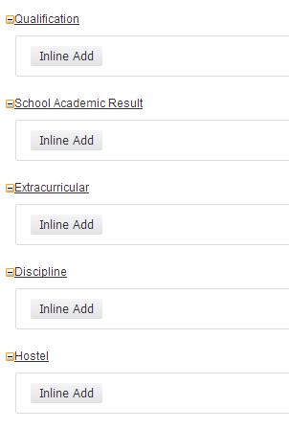
Student Record: Additional Information
1
Click EDIT button at student list
Check at the bottom of the student main record
2
Additional Information
Click Inline Add to insert Qualification, Academic Result, Extracurricular, Discipline and Hostel information for this student.

Slide 7
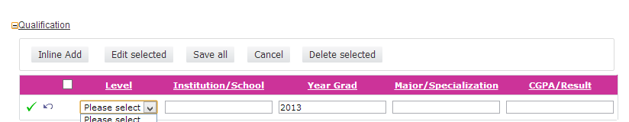
Student Record: Additional Information- Qualification
Click EDIT button at student list
2
1
Click Inline Add at Qualification menu
3
Fill in the relevant record
4
To save the record, Click ✓
5
To return to student list, click Back To List or if you want to go to next student click >>> or <<<
Tips: For multiple entry click Inline Add again and click SAVE ALL to save all records at once.

Slide 8
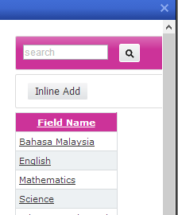
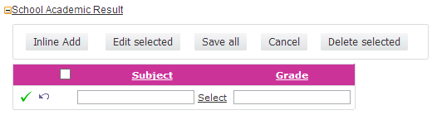
Student Record: Additional Information- School Academic Result
Click EDIT button at student list
2
1
Click Inline Add at School Academic Result
3
Select subject & type grade
Tips: You can add new subject by click INLINE ADD
4
Click Inline Add again and click SAVE ALL to save all records at once.

Slide 9
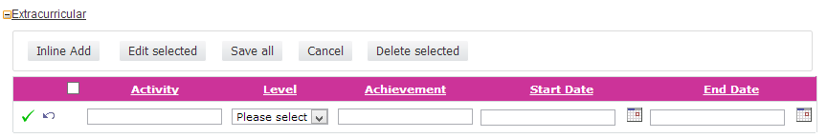
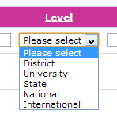
Student Record: Additional Information- Extracurricular
1
Click EDIT button at student list
2
Click Inline Add at Extracurricular
3
Fill in every field
4
To save the record, Click ✓

Slide 10
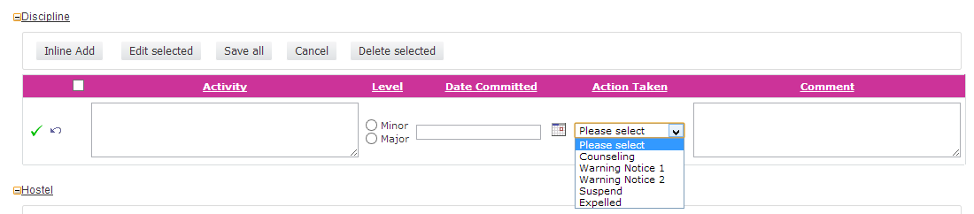
Student Record: Additional Information- Discipline
1
Click EDIT button at student list
2
Click Inline Add at Extracurricular
3
Fill in every field
4
To save the record, Click ✓

Slide 11
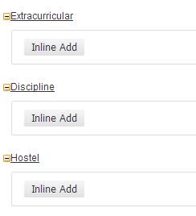
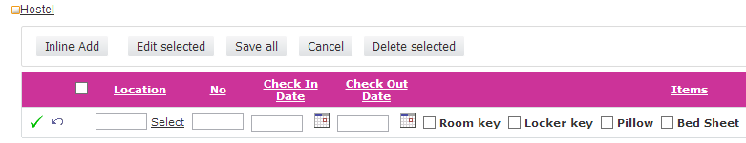
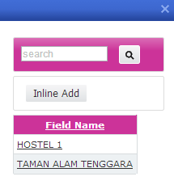
Student Record: Additional Information- Hostel
1
Click EDIT button at student list
2
Click Inline Add Hostel
3
Fill in every field
Tips: You can add new location by click INLINE ADD
4
To save the record, Click ✓

Slide 12
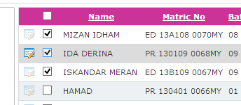
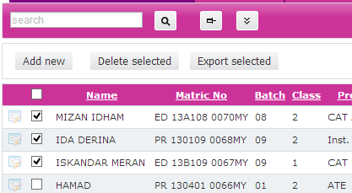
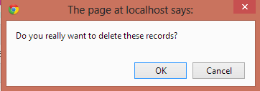
Student Record: How to delete student record?
1
Tick the checkbox at student’s list
2
Click DELETE SELECTED
3
Click OK to confirm delete

Slide 13
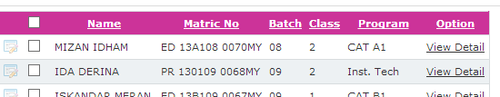
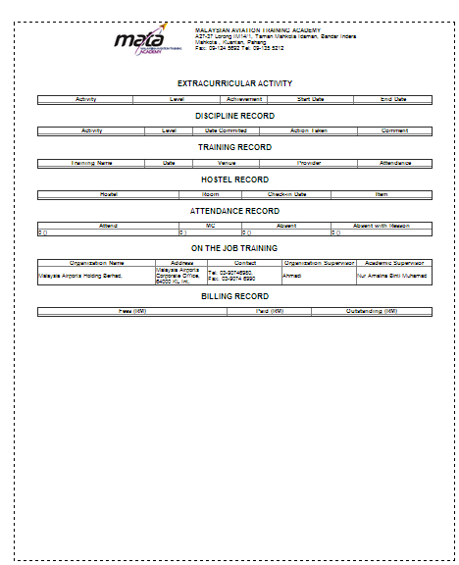
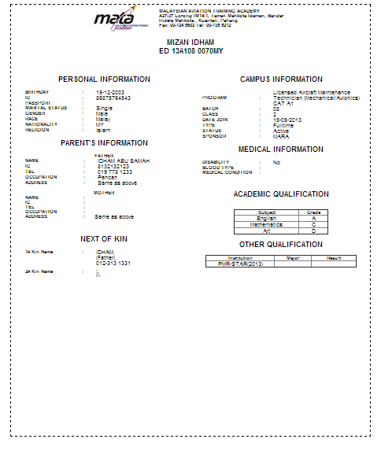
Student Record: View Detail
At Student List, Click VIEW DETAIL
1
2
New window will be open. You can print it directly from internet browser.

Slide 14
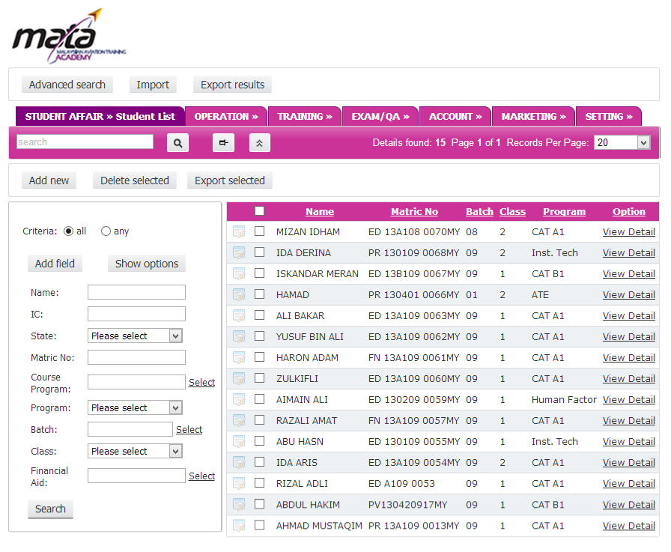
SEARCH: Overview
3
QUICK SEARCH – Find student name quickly
2
HIDE SEARCH OPTIONS
Toggle hide/show the search panel
5
4
SHOW OPTIONS-
Show range/interval input seach
ADD FIELD- Additional Search filter
1
SEARCH PANEL- Search area with important field

Slide 15
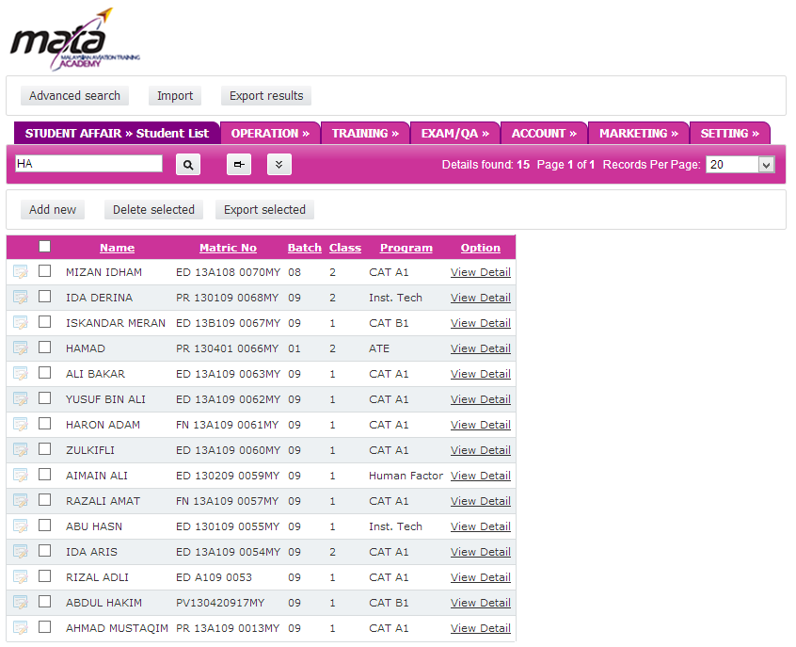
SEARCH
2
HIDE SEARCH OPTIONS
Toggle hide/show the search panel
2
1
SEARCH PANEL- Search area with common field. Type in one of those field and click SEARCH to proceed.

Slide 16
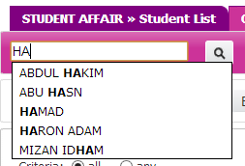
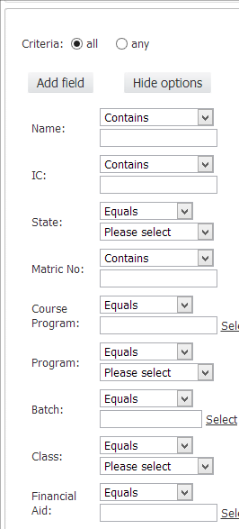

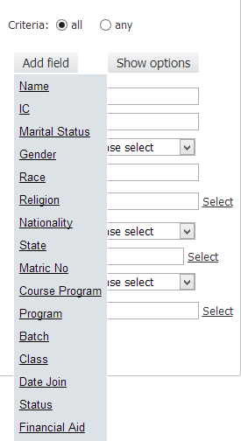
SEARCH:
3
QUICK SEARCH – Find student name quickly
SHOW OPTIONS-
Show range/interval input seach
4
5
ADD FIELD- Additional Search filter which not in search panel

Slide 17
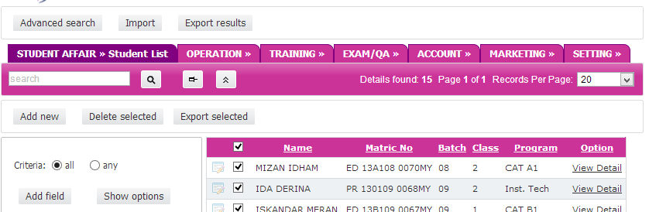
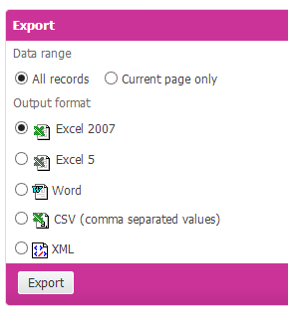
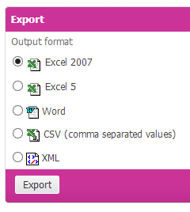
EXPORT
You can export record list to many format like EXCEL, WORD , CSV..
1
EXPORT RESULT- To export current page or all records
2
EXPORT SELECTED- To export selected data only

